Slide 1
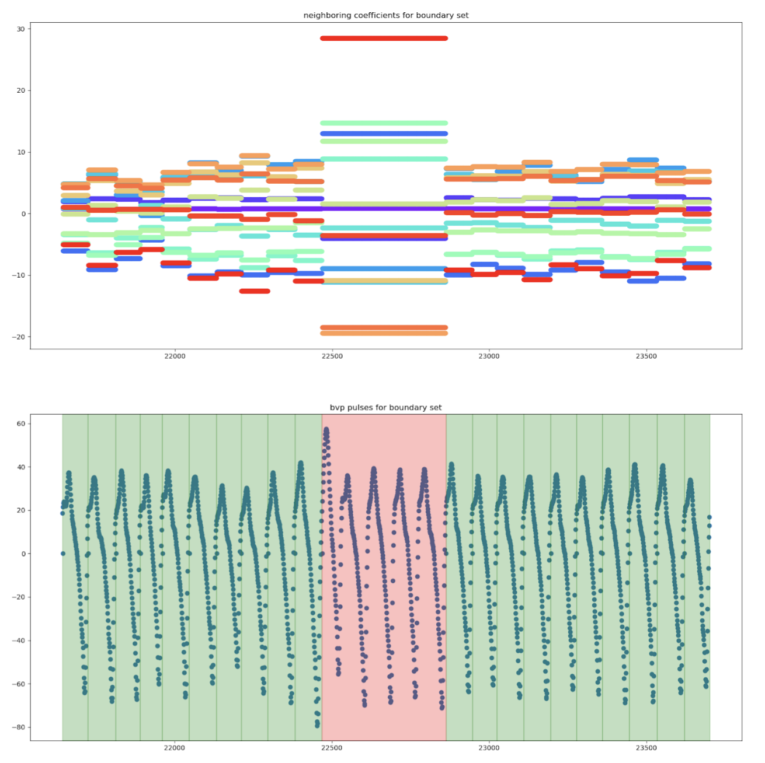
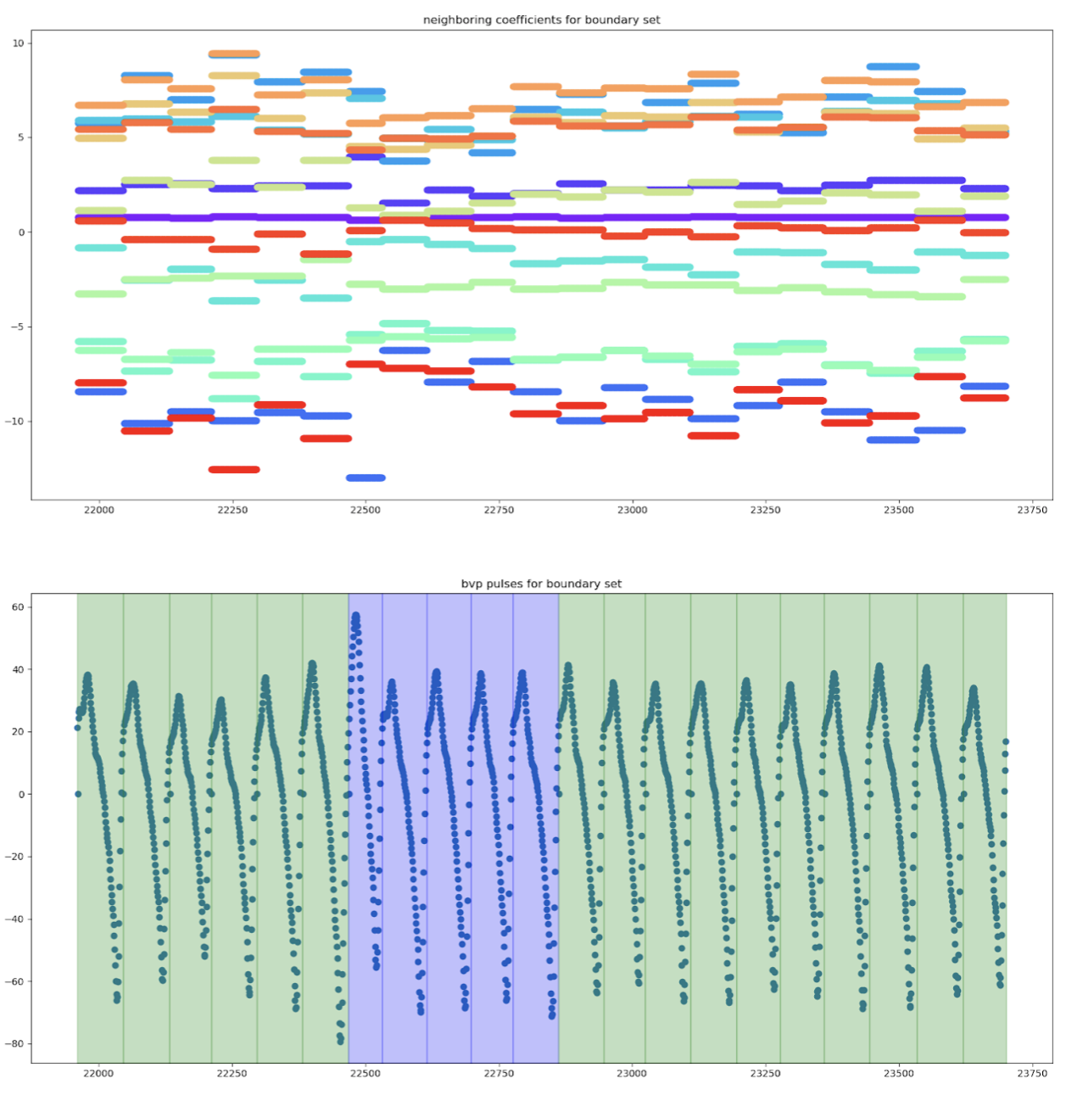
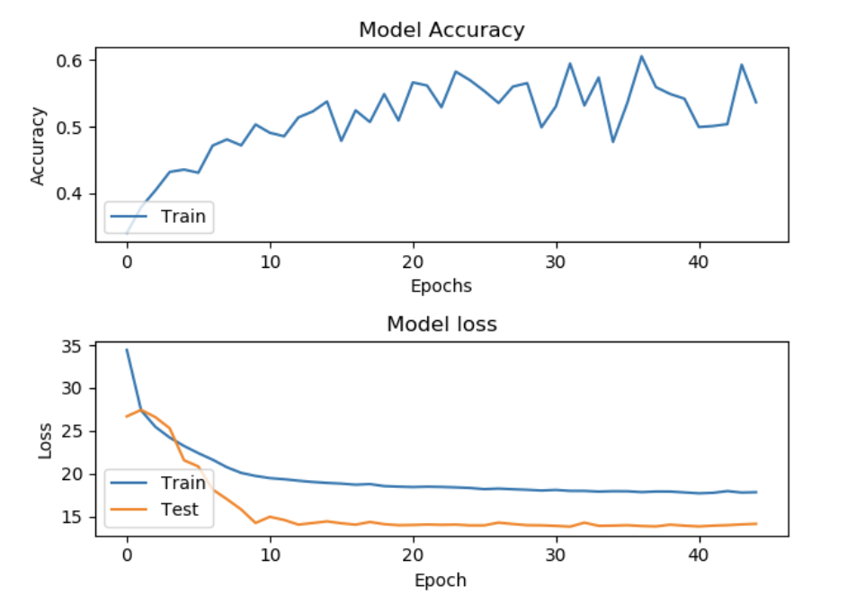

Using Machine Learning to Convey Emotion During Requirements Elicitation Interviews
UC-21
Abstract
Materials and Methods
Conclusions
During a requirements elicitation interview, it is hard to collect requirements due to the issue of ambiguity in communication the requirements analyst and the stakeholder. Detecting emotion has been used with machine learning (ML) in other studies; however, we use biofeedback data and other data in order to obtain emotional ranges from our ML model. The proposed solution was to create a deep artificial neural network to convey the emotional range based on image survey data collected from the stakeholder and biofeedback data collected using the Empatica E4 wristband. Once the survey data was translated into CSV files and biofeedback data normalized and polynomially regressed, the features were extracted and used as inputs for the ANN model. The model gave the emotional ranges which were three outputs that corresponded to the three scales from the image surveys. The built model had an accuracy of over 60%.
We programmed in Python using the Keras Tensorflow libraries. We had to clean and preprocess the data. The raw data that we received for use in our project needed to be transformed in several ways. Specifically, we needed to transform the data from being time-based to being heartbeat-based. While the Empatica E4 does delimit the data with heartbeat markers, it does so inaccurately. Thus, a big part of our project was fixing the misidentified heartbeat regions and fixing them so that the data could be used to train the artificial neural network. An example of a misidentified region and its fixed result is shown below. We also tested our model with several different optimizers, loss functions, number of epochs, number of hidden layers, hidden layer activation functions, and hidden units per layer.
We used a deep ANN in order to convey an emotional range based on the biofeedback data and the image survey data. From the biofeedback data, the blood volume pressure, electrodermal activity, acceleration, heart beat, and temperature, over time, were averaged by normalization and polynomial regression to use the coefficients as inputs into the model. The model was also tested using different techniques as seen in the results. The accuracy of the deep ANN was 63% which meant that the model would have that much of a better chance at giving the proper outputs for the emotional ranges based on the image surveys. While we were unable to predict the actual emotion with reliable confidence as we expected, we still found that our results were significant enough to show that we can determine emotions off of the biofeedback data provided that the way of collecting data during the interview would be changed to provide an actual emotion as we are using supervised learning.
Drawbacks of the project included difficulties converting the file types, distinguishing between the two speakers in the audio file, and just not having a good enough understanding of how to obtain features from the audio to output emotion. Also, the data cleaning, while extensive, was still not performing as well as desired. The misidentified regions in the post-processing algorithm still needs improvement, but is able to accurately identify missed heartbeat events a large percentage of the time. Solving these issues and successfully cleaning our data would allow the neural network to perform much better. In the future, we could implement the voice data into the project if the interviews were changed in a way that rendered the ability to gauge emotion.
Introduction
Emotion such as anger, happiness, sadness, bored, neutral, disgust, surprise, and fear [4][7] influence our daily communication and behavior. Studies have been conducted where emotion and machine learning have been used to determine the risks of people having been victimized by sexual assault [7], make connections with neighborhood crime rates [8], assist with issues in collecting data during elicitation interviews [5], and filter through speech and natural language [4].
Some current methods that are used to solve emotion detection problems are classification algorithms and deep learning algorithms such as one-vs-rest (OVR), support vector machines (SVM), Naive Bayes, K-nearest neighbor, multilayer perceptron, long-short-term-memory, and convoltional neural networks (CNN) [6]. We use an artificial neural network (ANN) model for our project. ANNs were introduced in 1943 by McCulloch and Pitts and work similar to the human brain [9]. We also used data pre-processing techniques similar to those discussed in [3] such as heartbeat segmentation. As part of the study for the arrhythmia classification techniques, a polynomial regression was used in the heartbeat segmentations process and the positions of these heartbeat peaks were used to separate the individual heartbeats [3].
Collecting requirements during requirements elicitation interviews is a highly difficult task because communication has many pitfalls that can invalidate the collection of requirements gathered by the requirements analyst from the stakeholder due to ambiguity in questions, statements, and responses [2]. During the interview, the requirements analyst interviews the stakeholder using the Empatica E4 which collects biofeedback such as heart rate and galvanic skin response [1].
Acknowledgments
This work was partially supported by NSF under grant CCF-1718377 “A Comprehensive Approach to Support the Requirements Analyst Before, During, and After Requirements Elicitation Interviews.” We would like to thank Dr. Paola Spoletini for providing us with the data for our project.
Results
Contact Information
Our deep ANN was able to achieve an accuracy of 63% on the testing data. We found that the loss function of the neural network had the most impact on the accuracy of the output layer. The neural network parameters which worked most optimally for us were:
Optimizer - Adam
Loss Function - Mean Squared Error
Number of Epochs - 45
Number of Hidden Layers - 5
Hidden Layer Activation Function - Leaky Relu
Hidden Units per Layer - 35
Norah Jean-Charles: norahjeanc@gmail.com
Alex Drennan: AlexDrennan@gmail.com
Gregor Hass: gregorhaas1997@gmail.com
https://github.com/NorahJC/MachineLearningProject
References
[1] Empatica 2018.E4 wristband from emaptica: user’s manual. Empatica. https://empatica.app.box.com/v/E4-User-Manual
[2] P. Spoletini, C. Brock, R. Shahwar, and A. Ferrari. 2016. Empowering requirements elicitation interviews with vocal and biofeedback analysis. In 2016 IEEE 24th International Requirements Engineering Conference (RE). IEEE, pp. 371–376. https://doi.org/10.1109/RE.2016.56
[3] Luz, E. J., Schwartz, W. R., Cámara-Chávez, G., & Menotti, D. (2016). ECG-based heartbeat classification for arrhythmia detection: A survey. Computer Methods and Programs in Biomedicine, 127, 144-164. Retrieved April 8, 2019.
[4] Absa, A. H., Deriche, M., & Mohandes, M. (2018). A Bilingual Emotion Recognition System Using Deep Learning Neural Networks. 2018 15th International Multi-Conference on Systems, Signals & Devices (SSD). doi:10.1109/ssd.2018.8570407
[5] R. W. Picard, E. Vyzas, and J. Healey (2001). Toward machine emotional intelligence: analysis of affective physiological state. IEEE Transactions on Pattern Analysis and Machine Intelligence, VOL.23, NO.10
[6] Sharifirad, S., Jafarpour, B., & Matwin, S. (2019). How is Your Mood When Writing Sexist tweets? Detecting the Emotion Type and Intensity of Emotion Using Natural Language Processing Techniques. Retrieved from http://search.ebscohost.com.proxy.kennesaw.edu/login.aspx?
direct=true&db=edsarx&AN=edsarx.1902.03089&site=eds-live&scope=site
[7] Melkonian, A. J., Ham, L. S., Bridges, A. J., & Fugitt, J. L. (2017). Facial emotion identification and sexual assault risk detection among college student sexual assault victims and nonvictims. Journal of American College Health, 65(7), 466–473. https://doi-org.proxy.kennesaw.edu/10.1080/07448481.2017.1341897
[8] McCoy, D. C., Roy, A. L., & Raver, C. C. (2016). Neighborhood crime as a predictor of individual differences in emotional processing and regulation. Developmental Science, 19(1), 164–174. Retrieved from https://doi-org.proxy.kennesaw.edu/10.1111/desc.12287
[9] Kwon, S. J. (2011). Artificial Neural Networks. New York: Nova Science Publishers, Inc. Retrieved from http://search.ebscohost.com.proxy.kennesaw.edu/login.aspx?direct=true&db=nlebk&AN=439593&site=eds-live&scope=site
Research Question(s)
Our project’s objective is conveying emotional ranges of stakeholders during requirements elicitation interviews. The ranges are represented by three scales from the image surveys going from 0 to 100 that all incorporate neutral (50): very negative to very positive, calm to excited, and relax to stimulated. We are using a deep artificial neural network (ANN) and supervised learning.
To address the issue of ambiguity between the requirements analyst and the stakeholder and to assist with gathering requirements, the objective is to use a deep ANN to convey the emotional range of the stakeholder using features from biofeedback data. The main questions to answer as part of this research were: (1) What machine learning technique(s) would be most efficient in conveying the emotion of the stakeholder through the biofeedback data? (2) What features and techniques would result in optimal performance from the chosen machine learning technique(s)?
Authors: Norah Jean-Charles, Alex Drennan, and Gregor Haas
Advisor: Dr. Mohammed Aledhari

